Slide 1
session hijacking
Final Year Project

Slide 2
Team Members: Asma rubab(bscs51f21s045) Fareeha Adrees(bscs51f21s038) Hadia waheed(bscs51f21s041)
Supervisor:sir farooq
Institute:University Of Sargodha

Slide 3
introduction Session
A session in the context of web applications is a series of interactions between a user and a server. During a session, the server maintains a state of the user, allowing them to navigate different pages without relogging in.

Slide 4
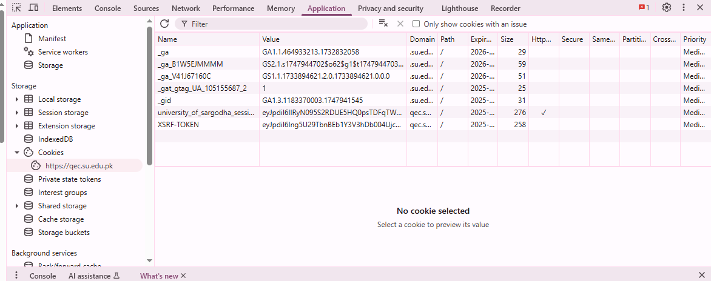

Slide 5

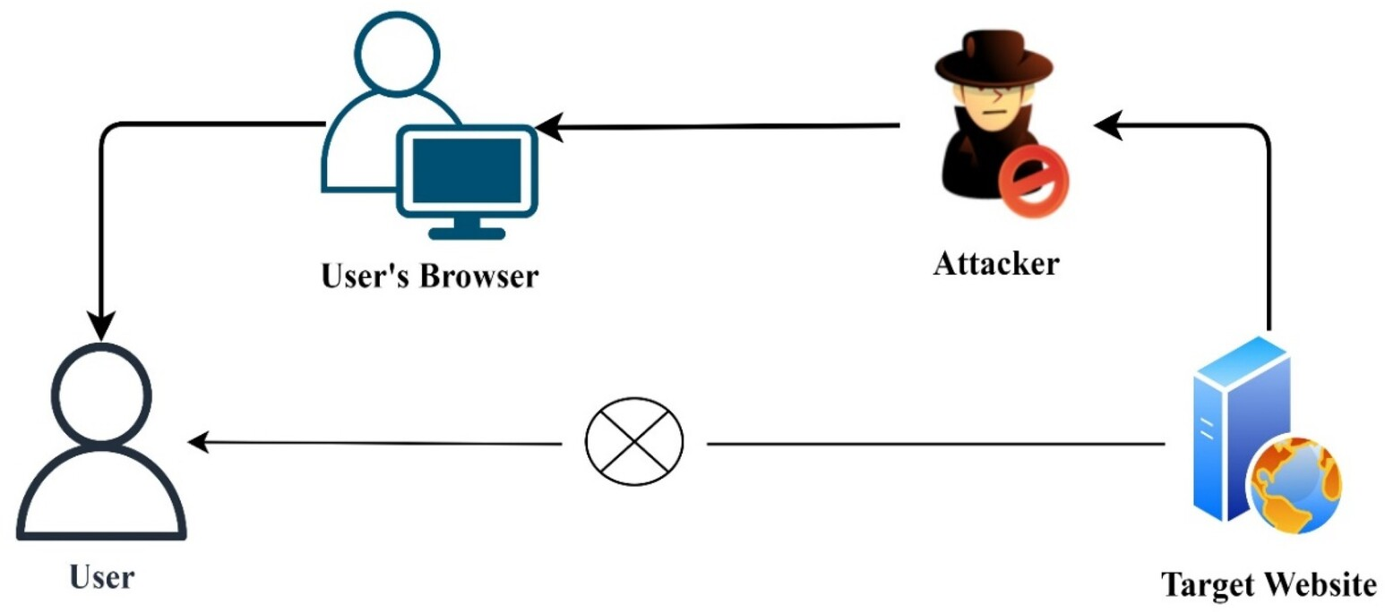
Session Hijacking
Session hijacking is a web attack where a malicious user takes control over a valid user session. Once hijacked, the attacker can act as the legitimate user..

Slide 6
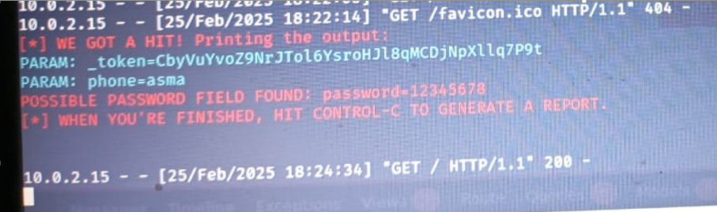
Password Found

Slide 7

Objectives
Builds skills in identifying and mitigating security threats.
Simulate session hijacking attacks ethically and collect real data from 2000+ websites.
Build a secure and custom dataset based on real-world vulnerability patterns.
Helps you learn how sessions work and how attacks occur.
Model can help spot websites that may be at risk of session hijacking.

Slide 8
Work flow
Website Selection: Targeted over 2000 real-world websites.
Data Collection: Extracted session headers, cookies, and tokens
Dataset Creation: Labeled data using expert rules and attack outcomes.
Model Training: for vulnerability prediction.
Web Development: Created a user-friendly UI for input and reports.
Integration & Testing: Combined all modules into a working tool.

Slide 9
Tools & Technologies
Kali Linux: For simulating ethical attacks (e.g., session side-jacking, fixation).
Selenium and Python: For automated data collection (cookies, headers, tokens).
Pandas and Scikit-learn: For data processing and machine learning.
Google Colab: For training and evaluating the model.
Flask + HTML/CSS/JS: To build the web interface and integrate the model.

Slide 10
Challenges in Manual Scanning
In the previous semester, we conducted vulnerability scanning on university websites using multiple Kali Linux tools like Nmap, Nikto, Whatweb and Burp Suite.
Collecting session-related data from a single website using different tools was time-consuming and technically challenging.
Each tool provided different types of outputs, which made it hard to combine and analyze results easily.
Non-technical users cannot rely on these tools because they require manual setup and expert knowledge.

Slide 11
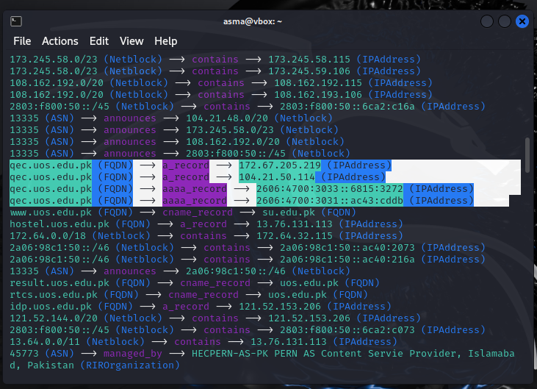
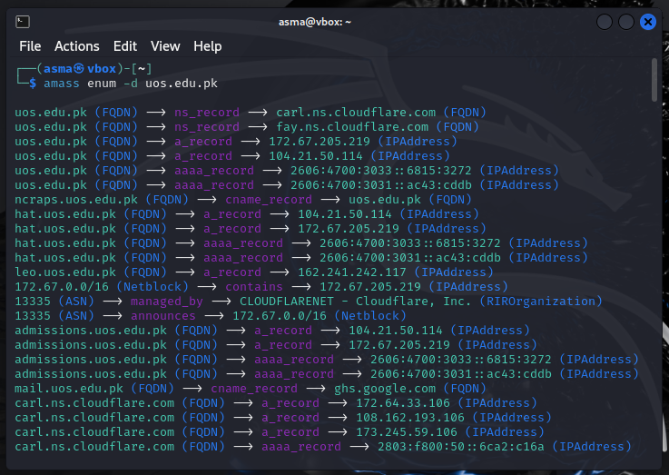
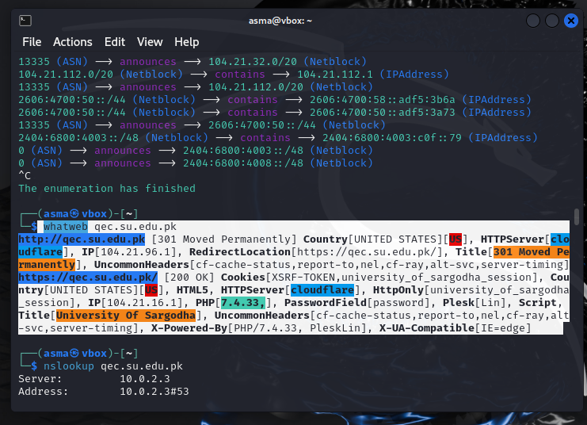

Slide 12
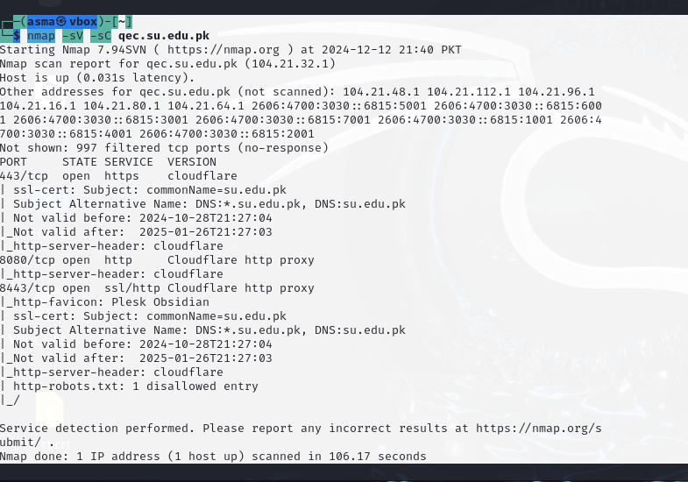
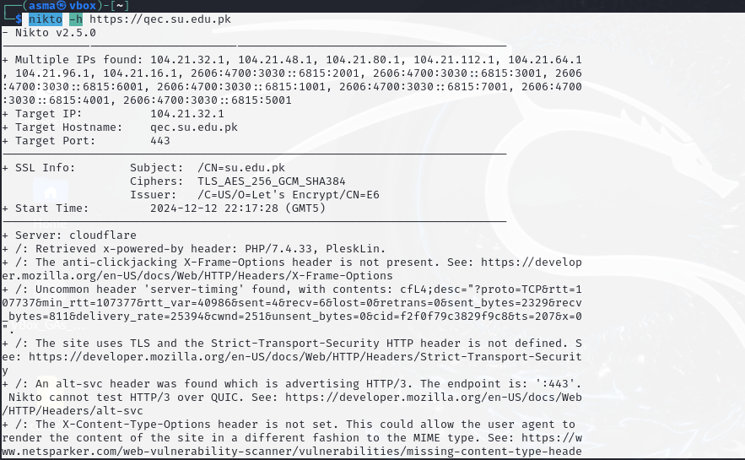
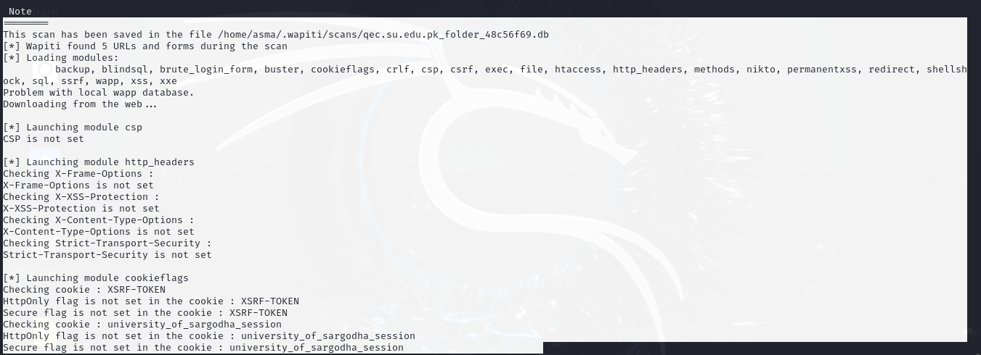

Slide 13
This experience highlighted the gap — we realized the need for a unified, automated framework that focuses specifically on session hijacking vulnerabilities, and is easy to use, even for users without cybersecurity expertise.

Slide 14
Tools used for Security Testing
Burp Suite
ZAP proxy
OWASP zap
Nikto
Nmap
Whatweb
These tools scan broad security areas, not specifically focused on session hijacking.
Require technical expertise to operate.
No unified report focused solely on session-related risks like cookies, tokens, and headers.

Slide 15
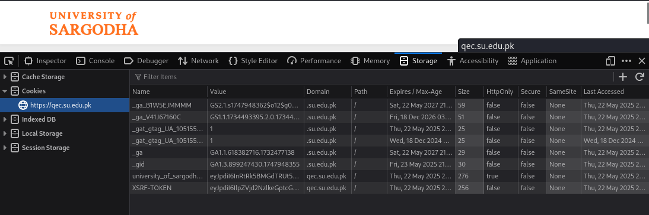
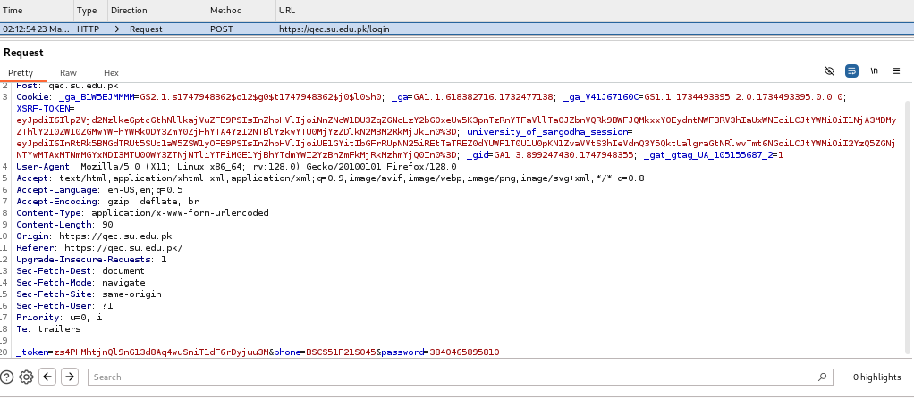

Slide 16
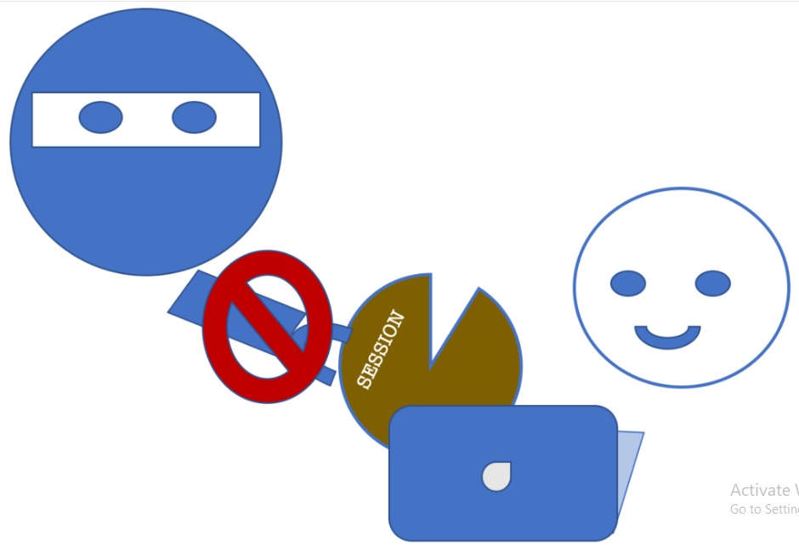
Why is this system needed?
Why Is This System Needed?
With the rise of web applications, session hijacking has become a major threat to user privacy and security.
Many existing tools are too broad or complex, lacking a focus on session-based vulnerabilities.
We wanted to develop a focused and intelligent tool to help developers and website owners detect and fix session hijacking risks effectively.

Slide 17
Real-World Session Hijacking Incidents
Zeus Banking Trojan (2007–2013)
A notorious malware that hijacked online banking sessions.It stole session cookies and login tokens after the user logged in.Then, it silently performed transactions from the same session, without triggering OTP or alerts.
Facebook Session Hijacking (2011)
Multiple ethical hackers demonstrated that if a user's session cookie is stolen (e.g., via XSS or unsecured network), the attacker can take full control of their Facebook account.
Parler App Breach (2021)
During the U.S. Capitol riot investigation, researchers accessed session tokens and unencrypted URLs, exposing private posts and user data.
Firesheep Extension – Public WiFi Exploit (2010)
A Firefox plugin called Firesheep allowed attackers to hijack sessions over public WiFi.
Thousands of Facebook, Twitter, and Amazon accounts were exposed.

Slide 18
Dataset Creation Process
We built a custom dataset focused entirely on session hijacking vulnerabilities, as no existing dataset covered this domain specifically.
Target Websites Selection
Automated Scanning
Data Storage & Labeling
Stored results in structured CSV files.
Each entry includes:
Domain
Session-related headers (e.g., Set-Cookie, Secure, HttpOnly, SameSite)
Vulnerability status (Yes/No)
Type of issue (e.g., Weak Cookie Flags, Token Exposure)

Slide 19
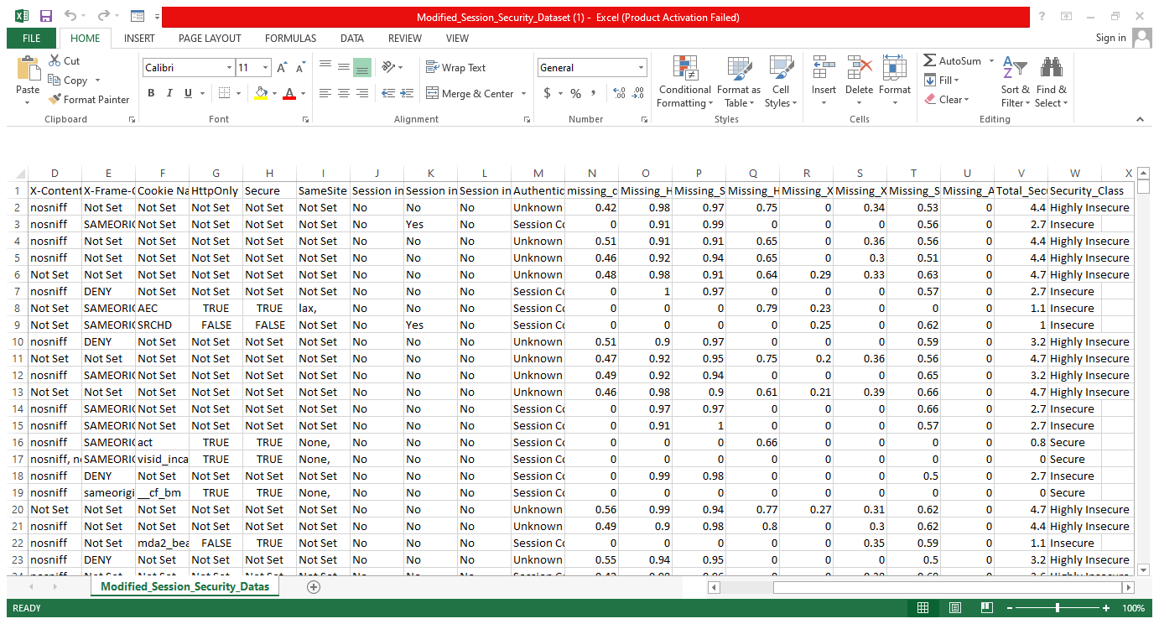

Slide 20
Model Training & Evaluation
After preparing our custom dataset, we trained three different machine learning models to detect session hijacking vulnerabilities:
Models Used for Training
Decision Tree
Random Forest
XGBoost

Slide 21
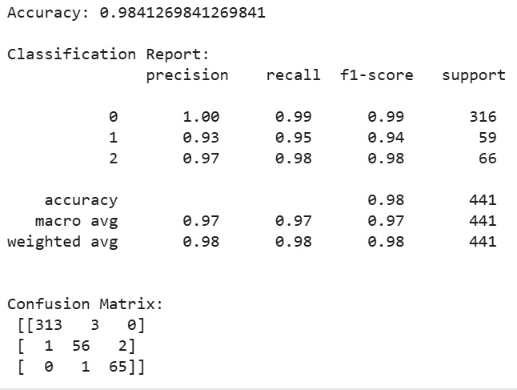
Random Forest Classifier is an ensemble algorithm that builds multiple decision trees and combines their results to make the final prediction. Each tree is trained on a random subset of data and features, which improves accuracy and robustness.

Slide 22
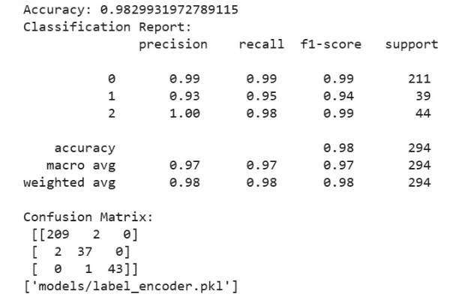
A Decision Tree is an algorithm that splits data based on features through multiple questions. This process continues until the data is divided into pure groups, where each leaf node gives the final decision (class or value).

Slide 23
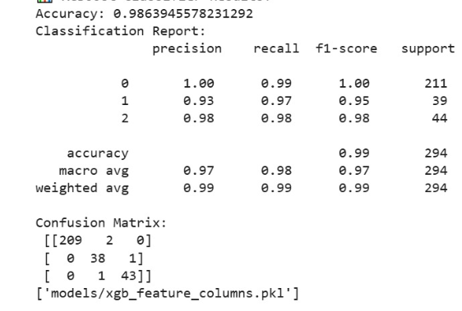
XGBoost algorithm first builds a simple decision tree, then the next tree is created to correct the errors made by the previous one. This process repeats multiple times, making the model gradually more accurate.

Slide 24
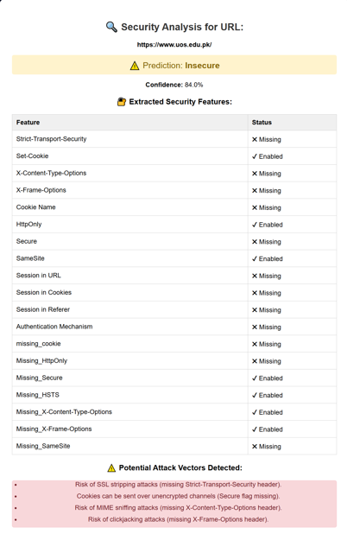
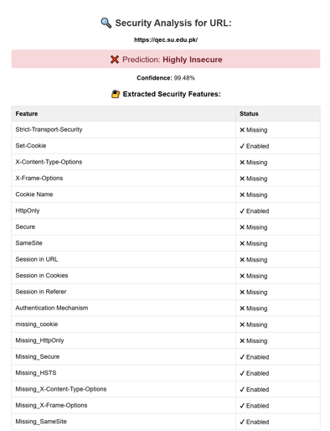
Comparison

Slide 25
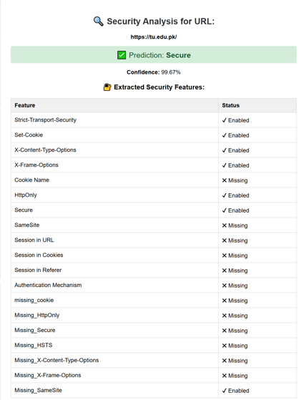
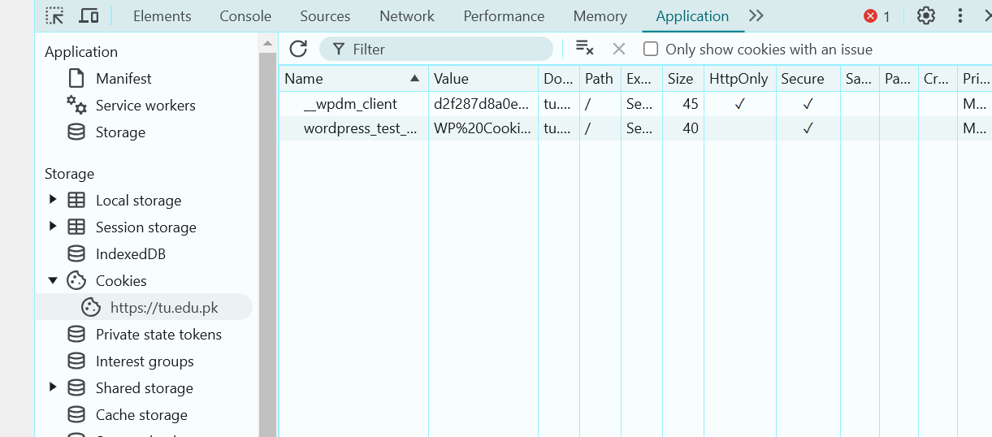

Slide 26

What Problem Are We Solving?
Session hijacking allows attackers to take over valid user sessions, often without detection.
Tools like OWASP ZAP and Nmap scan for general vulnerabilities but do not focus specifically on session management.
Our goal was to create an AI-powered tool that detects only session-related vulnerabilities with detailed analysis and reporting.

Slide 27
Future Enhancements
Expanding the Dataset
Increase the number of websites to improve model accuracy. Add more real-world cases and vulnerability types. Include multi-language and platform-specific session behaviors.
User Authentication (Login/Logout)
Add secure login/logout system for each user.
Each user can manage:
Their own scanned data
Saved reports
Scan history
Database Integration
Store all scanned reports in a centralized database.
Allow users to:
View past scans
Track changes over time
Compare multiple websites.

Slide 28


Real-World Importance
The project focuses solely on session management vulnerabilities.
Includes detection of insecure session cookies, missing security headers, token exposure, and simulated attack vectors.
The tool is platform-independent and works for all types of websites.
Designed to be simple and user-friendly, even for non-technical users.

Slide 29
Key Features
AI-driven detection of session hijacking vulnerabilities.
Real-time website scanning with instant results.
Simulates session-based attacks (e.g., session fixation).
Detect insecure session configurations in multiple real websites.
Generates a detailed session security report with severity scores.

Slide 30
benefits
Real-Time Decision Making
End users can instantly check the security of a website by simply entering the URL, ensuring they don't unknowingly expose themselves to risks while browsing.
Building Trust in Secure Platforms
Your model helps users identify trustworthy platforms, contributing to a safer online environment and reinforcing their trust in websites that are marked as secure.

Slide 31
benefits
Preventing Unauthorized Access
If a website is flagged as insecure, users can refrain from logging in or providing personal data, protecting themselves from identity theft and fraud.Motivates Users with History Tracking
Protection from Cyber Threats
By detecting insecure websites, users can avoid sites where their session could be hijacked, reducing the risk of their data being stolen or their accounts being compromised

Slide 32
Real life use-cases
Subscription Services
Protect user accounts and subscriptions from unauthorized access.
E-learning websites and platforms that host student data can use the detection tool to protect their users from session hijacking during online classes or exam submissions.

Slide 33
Conclusion
It compromises user privacy, leads to data theft, and can result in unauthorized transactions.
Awareness of session hijacking risks and how to detect them can significantly improve website security.
The classification model helps identify vulnerable websites and classifies them as secure or at risk.
The project can be expanded to detect other web security issues and enhanced by integrating additional features

Slide 34
THANK YOU

